Slide 1
T-SQL Concepts II

Slide 2
CONCEPTS
GLOBAL AND TEMPORARY TABLES
STORED PROCEDURES
PARAMETERS
VARIABLES
OUTPUT PARAMETERS
BEGIN END
CONTROL FLOW STATEMENTS(IF,WHILE,BREAK,CONTINUE)

Slide 3
TEMPORARY TABLES
Temporary tables are tables that exist temporarily on the SQL Server.
The temporary tables are useful for storing the immediate result sets that are accessed multiple times.
The temporary table name created in the system database named tempdb, which
can be accessed via the SQL Server Management Studio using the following path
System Databases > tempdb > Temporary Tables.
The temporary table also consists of a sequence of numbers as a postfix.
This is a unique identifier for the temporary table.
Because multiple database connections can create temporary tables with the same name, SQL Server automatically appends this unique number at the end of the temporary table name to differentiate between the temporary tables.
SQL Server provided two ways to create temporary tables via SELECT INTO and CREATE TABLE statements.

Slide 4

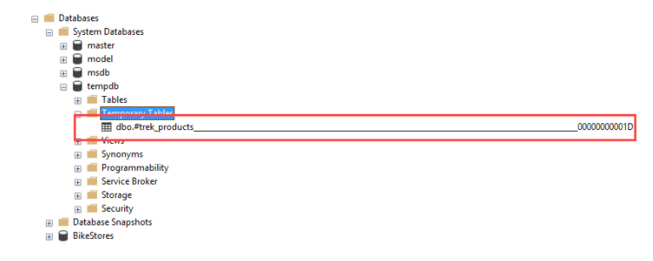

Slide 5
Create temporary tables using SELECT INTO statement
SELECT
select_list
INTO
temporary_table
FROM
table_name
....
SELECT
product_name,
list_price
INTO #trek_products --- temporary table
FROM
production.products
WHERE
brand_id = 9;

Slide 6
Create temporary tables using CREATE TABLE statement
CREATE TABLE #haro_products (
product_name VARCHAR(MAX),
list_price DEC(10,2)
);
INSERT INTO #haro_products
SELECT
product_name,
list_price
FROM
production.products
WHERE
brand_id = 2;
SELECT * FROM #haro_products;

Slide 7
GLOBAL TEMPORARY TABLES
Sometimes, you may want to create a temporary table that is accessible across connections. In this case, you can use global temporary tables.
Unlike a temporary table, the name of a global temporary table starts with a double hash symbol (##).
INSERT INTO ##heller_products
SELECT
product_name,
list_price
FROM
production.products
WHERE
brand_id = 3;
CREATE TABLE ##heller_products (
product_name VARCHAR(MAX),
list_price DEC(10,2)
);

Slide 8
DROPPING TEMPORARY TABLES
Automatic removal
SQL Server drops a temporary table automatically when you close the connection that created it.
SQL Server drops a global temporary table once the connection that created it closed and the queries against this table from other connections completes.
Manual Deletion
From the connection in which the temporary table created, you can manually remove the temporary table by using the DROP TABLE statement:
DROP TABLE ##table_name;

Slide 9
SQL Server Stored Procedures
SQL Server stored procedures are used to group one or more Transact-SQL statements into logical units.
The stored procedure are stored as named objects in the SQL Server Database Server.
When you call a stored procedure for the first time, SQL Server creates an execution plan and stores it in the cache.
In the subsequent executions of the stored procedure, SQL Server reuses the plan so that the stored procedure can execute very fast with reliable performance.

Slide 10
Creating a simple stored procedure
CREATE PROCEDURE uspProductList
AS
BEGIN
SELECT
product_name,
list_price
FROM
production.products
ORDER BY
product_name;
END;

Slide 11
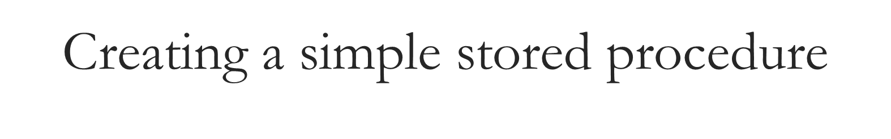
The uspProductList is the name of the stored procedure.
The AS keyword separates the heading and the body of the stored procedure.
If the stored procedure has one statement, the BEGIN and END keywords surrounding the statement are optional. However, it is a good practice to include them to make the code clear.
Note that in addition to the CREATE PROCEDURE keywords, you can use the CREATE PROC keywords to make the statement shorter.
You can find the stored procedure in the Object Explorer, under
Programmability > Stored Procedures.

Slide 12
Executing a stored procedure
To execute a stored procedure, you use the EXECUTE or EXEC statement
followed by the name of the stored procedure:
EXECUTE sp_name;
EXEC sp_name;
where sp_name is the name of the stored procedure that you want to execute.
For example, to execute the uspProductList stored procedure, you use the following statement:
EXEC uspProductList;

Slide 13
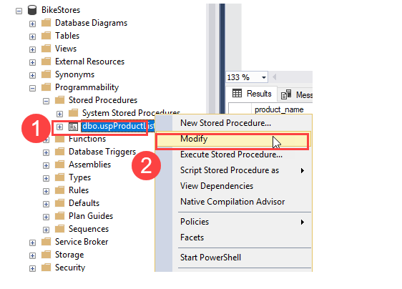
Modifying a stored procedure
To modify an existing stored procedure, you use the ALTER PROCEDURE statement.
First, open the stored procedure to view its contents by right-clicking the stored procedure name and select Modify menu item:

Slide 14
Modifying a stored procedure
Second, change the body of the stored procedure by sorting the products by list prices instead of product names:
ALTER PROCEDURE uspProductList
AS
BEGIN
SELECT
product_name,
list_price
FROM
production.products
ORDER BY
list_price
END;

Slide 15
Deleting a stored procedure
To delete a stored procedure, you use the DROP PROCEDURE or DROP PROC statement:
DROP PROCEDURE sp_name;
or
DROP PROC sp_name;
For example, to remove the uspProductList stored procedure, you execute the following statement:
DROP PROCEDURE uspProductList;

Slide 16
SQL Server Stored Procedure Parameters
We will extend the stored procedure which allows you to pass one or more values to it.
The result of the stored procedure will change based on the values of the parameters.
Creating a stored procedure with one parameter:
ALTER PROCEDURE uspFindProducts(@min_list_price AS DECIMAL)
AS
BEGIN
SELECT
product_name,
list_price
FROM
production.products
WHERE
list_price >= @min_list_price
ORDER BY
list_price;
END;

Slide 17
SQL Server Stored Procedure Parameters
In this example:
First, we added a parameter named @min_list_price to the uspFindProducts stored procedure.
Every parameter must start with the @ sign.
The AS DECIMAL keywords specify the data type of the @min_list_price parameter.
The parameter must be surrounded by the opening and closing brackets.
Second, we used @min_list_price parameter in the WHERE clause of the SELECT statement to filter only the products whose list prices are greater than or equal to the @min_list_price.
To execute the uspFindProducts stored procedure, you pass an argument to it as follows:
EXEC uspFindProducts 100;

Slide 18
Creating a stored procedure with multiple parameters
Stored procedures can take one or more parameters. The parameters are separated by commas.
The following statement modifies the uspFindProducts stored procedure by adding one more parameter named @max_list_price to it:
ALTER PROCEDURE uspFindProducts(
@min_list_price AS DECIMAL
,@max_list_price AS DECIMAL
)
AS
BEGIN
SELECT
product_name,
list_price
FROM
production.products
WHERE
list_price >= @min_list_price AND
list_price <= @max_list_price
ORDER BY
list_price;
END;
EXECUTE uspFindProducts 900, 1000;

Slide 19
Using named parameters
In case stored procedures have multiple parameters, it is better and more clear to execute the stored procedures using named parameters.
For example, the following statement executes the uspFindProducts stored procedure using the named parameters @min_list_priceand @max_list_price:
EXECUTE uspFindProducts
@min_list_price = 900,
@max_list_price = 1000;

Slide 20
Creating text parameters
The following statement adds the @name parameter as a character string parameter to the stored procedure.
ALTER PROCEDURE uspFindProducts(
@min_list_price AS DECIMAL
,@max_list_price AS DECIMAL
,@name AS VARCHAR(max)
)
AS
BEGIN
SELECT
product_name,
list_price
FROM
production.products
WHERE
list_price >= @min_list_price AND
list_price <= @max_list_price AND
product_name LIKE '%' + @name + '%'
ORDER BY
list_price;
END;

Slide 21

In the WHERE clause of the SELECT statement, we added the following condition:
product_name LIKE '%' + @name + '%‘
By doing this, the stored procedure returns the products whose list prices are in the range of min and max list prices and the product names also contain a piece of text that you pass in.
Once the stored procedure is altered successfully, you can execute it as follows:
EXECUTE uspFindProducts
@min_list_price = 900,
@max_list_price = 1000,
@name = 'Trek';
In this statement, we used the uspFindProducts stored procedure to find the product whose list prices are in the range of 900 and 1,000 and their names contain the word Trek.

Slide 22
Creating Optional Parameters
SQL Server allows you to specify default values for parameters so that when you call stored procedures, you can skip the parameters with default values.
ALTER PROCEDURE uspFindProducts(
@min_list_price AS DECIMAL = 0
,@max_list_price AS DECIMAL = 999999
,@name AS VARCHAR(max)
)
AS
BEGIN
SELECT
product_name,
list_price
FROM
production.products
WHERE
list_price >= @min_list_price AND
list_price <= @max_list_price AND
product_name LIKE '%' + @name + '%'
ORDER BY
list_price;
END;

Slide 23

In this stored procedure, we assigned 0 as the default value for the @min_list_price parameter and 999,999 as the default value for the @max_list_price parameter.
Once the stored procedure is compiled, you can execute it without passing the arguments to @min_list_price and @max_list_price parameters:
EXECUTE uspFindProducts @name = 'Trek';
In this case, the stored procedure used 0 for @min_list_price parameter and 999,999 for the @max_list_price parameter when it executed the query.
The @min_list_price and @max_list_price parameters are called optional parameters.
EXECUTE uspFindProducts @min_list_price = 6000, @name = 'Trek';

Slide 24
Using NULL as the default value
In the uspFindProducts stored procedure, we used 999,999 as the default maximum list price. This is not robust because in the future you may have products with the list prices that are greater than that.
A typical technique to avoid this is to use NULL as the default value for the parameters:
ALTER PROCEDURE uspFindProducts(
@min_list_price AS DECIMAL = 0
,@max_list_price AS DECIMAL = NULL
,@name AS VARCHAR(max)
)
AS
BEGIN
SELECT
product_name,
list_price
FROM
production.products
WHERE
list_price >= @min_list_price AND
(@max_list_price IS NULL OR list_price <= @max_list_price) AND
product_name LIKE '%' + @name + '%'
ORDER BY
list_price;
END;

Slide 25
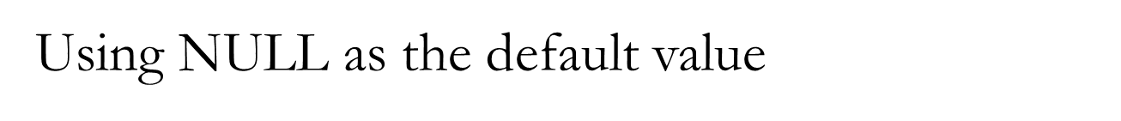
In the WHERE clause, we changed the condition to handle NULL value for the @max_list_price parameter:
(@max_list_price IS NULL OR list_price <= @max_list_price)
The following statement executes the uspFindProducts stored procedure to find the product whose list prices are greater or equal to 500 and names contain the word Haro
EXECUTE uspFindProducts
@min_list_price = 500,
@name = 'Haro';

Slide 26
Variables
A variable is an object that holds a single value of a specific type e.g., integer, date, or varying character string.
We typically use variables in the following cases:
As a loop counter to count the number of times a loop is performed.
To hold a value to be tested by a control-of-flow statement such as WHILE.
To store the value returned by a stored procedure or a function.
Declaring a variable:
The DECLARE statement initializes a variable by assigning it a name and a data type.
The variable name must start with the @ sign.
In this example, the data type of the @model_year variable is SMALLINT.
DECLARE @model_year SMALLINT;
By default, when a variable is declared, its value is set to NULL.
Between the variable name and data type, you can use the optional AS keyword as follows:
DECLARE @model_year AS SMALLINT;
To declare multiple variables, you separate variables by commas:
DECLARE @model_year SMALLINT,
@product_name VARCHAR(MAX);

Slide 27
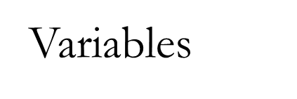
Assigning a value to a variable:
To assign a value to a variable, you use the SET statement. For example, the following statement assigns 2018 to the @model_year variable:
SET @model_year = 2018;
DECLARE @model_year SMALLINT;
SET @model_year = 2018;
SELECT
product_name,
model_year,
list_price
FROM
production.products
WHERE
model_year = @model_year
ORDER BY
product_name;

Slide 28
Storing Query Result in a Variable
First, declare a variable named @product_count with the integer data type:
DECLARE @product_count INT;
Second, use the SET statement to assign the query’s result set to the variable:
SET @product_count = (
SELECT
COUNT(*)
FROM
production.products
);
Third, output the content of the @product_count variable:
SELECT @product_count;
Or you can use the PRINT statement to print out the content of a variable:
PRINT @product_count;
or
PRINT 'The number of products is ' + CAST(@product_count AS VARCHAR(MAX));

Slide 29
The output in the messages tab is as follows:
The number of products is 204
To hide the number of rows affected messages, you use the following statement:
SET NOCOUNT ON

Slide 30
Selecting a record into variables
First, declare variables that hold the product name and list price:
DECLARE
@product_name VARCHAR(MAX),
@list_price DECIMAL(10,2);
Second, assign the column names to the corresponding variables:
SELECT
@product_name = product_name,
@list_price = list_price
FROM
production.products
WHERE
product_id = 100;
Third, output the content of the variables:
SELECT
@product_name AS product_name,
@list_price AS list_price;

Slide 31
Accumulating values into a variable
The following stored procedure takes one parameter and returns a list of products as a string:
CREATE PROC uspGetProductList(
@model_year SMALLINT
) AS
BEGIN
DECLARE @product_list VARCHAR(MAX);
SET @product_list = '';
SELECT
@product_list = @product_list + product_name
+ CHAR(10)
FROM
production.products
WHERE
model_year = @model_year
ORDER BY
product_name;
PRINT @product_list;
END;

Slide 32
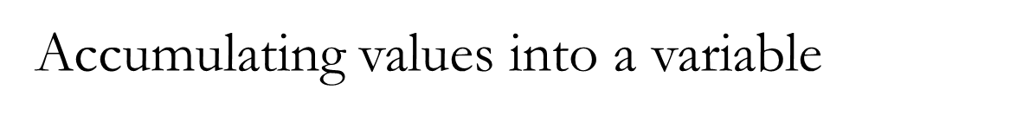
In this stored procedure:
First, we declared a variable named @product_list with varying character string type and set its value to blank.
Second, we selected the product name list from the products table based on the input @model_year. In the select list, we accumulated the product names to the @product_list variable. Note that the CHAR(10) returns the line feed character.
Third, we used the PRINT statement to print out the product list.
The following statement executes the uspGetProductList stored procedure:
EXEC uspGetProductList 2018

Slide 33
Stored Procedure Output Parameters
The output parameters are used to return data back to the calling program.
Creating output parameters:
parameter_name data_type OUTPUT
A stored procedure can have many output parameters. In addition, the output parameters can be in any valid data type e.g., integer, date, and varying character.

Slide 34

CREATE PROCEDURE uspFindProductByModel (
@model_year SMALLINT,
@product_count INT OUTPUT
) AS
BEGIN
SELECT
product_name,
list_price
FROM
production.products
WHERE
model_year = @model_year;
SELECT @product_count = @@ROWCOUNT;
END;
First, we created an output parameter named @product_count to store the number of products found:
@product_count INT OUTPUT
@@ROWCOUNT is a system variable that returns the number of rows read by the previous statement.

Slide 35
Calling stored procedures with output parameters
To call a stored procedure with output parameters, you follow these steps:
First, declare variables to hold the values returned by the output parameters
Second, use these variables in the stored procedure call.
For example, the following statement executes the uspFindProductByModel stored procedure:
First, declare the @count variable to hold the value of the output parameter of the stored procedure.
Then, execute the uspFindProductByModel stored procedure and passing the parameters:
DECLARE @count INT;
EXEC uspFindProductByModel @model_year = 2018,@product_count = @count OUTPUT;
SELECT @count AS 'Number of products found';
You can call the uspFindProductByModel stored procedure as follows:
EXEC uspFindProductByModel 2018, @count OUTPUT;
Note that if you forget the OUTPUT keyword after the @count variable, the @count variable will be NULL.
Finally, show the value of the @count variable:
SELECT @count AS 'Number of products found';

Slide 36
SQL Server BEGIN END
The BEGIN...END statement is used to define a statement block.
A statement block consists of a set of SQL statements that execute together. A statement block is also known as a batch.
In other words, if statements are sentences, the BEGIN...END statement allows you to define paragraphs.
The BEGIN... END statement bounds a logical block of SQL statements. We often use the BEGIN...END at the start and end of a stored procedure and function. But it is not strictly necessary.
However, the BEGIN...END is required for the IF ELSE statements, WHILE statements, etc., where you need to wrap multiple statements.
The following illustrates the syntax of the BEGIN...END statement:
BEGIN
{ sql_statement | statement_block}
END

Slide 37
Nesting BEGIN... END
You can place a BEGIN...END statement within another BEGIN... END statement.
BEGIN
DECLARE @name VARCHAR(MAX);
SELECT TOP 1
@name = product_name
FROM
production.products
ORDER BY
list_price DESC;
IF @@ROWCOUNT <> 0
BEGIN
PRINT 'The most expensive product is ' + @name
END
ELSE
BEGIN
PRINT 'No product found';
END;
END

Slide 38
SQL Server IF ELSE
The IF...ELSE statement is a control-flow statement that allows you to execute or skip a statement block based on a specified condition.
IF boolean_expression
BEGIN
{ statement_block }
END
The IF ELSE statement:
When the condition in the IF clause evaluates to FALSE and you want to execute another statement block, you can use the ELSE clause.
IF Boolean_expression
BEGIN
-- Statement block executes when the Boolean expression is TRUE
END
ELSE
BEGIN
-- Statement block executes when the Boolean expression is FALSE
END

Slide 39
Nested IF...ELSE
When the condition in the IF clause evaluates to FALSE and you want to execute another statement block, you can use the ELSE clause.
BEGIN
DECLARE @x INT = 10,
@y INT = 20;
IF (@x > 0)
BEGIN
IF (@x < @y)
PRINT 'x > 0 and x < y';
ELSE
PRINT 'x > 0 and x >= y';
END
END
Here is the output:
x > 0 and x < y
It is a good practice to not nest an IF statement inside another statement because it makes the code difficult to read and hard to maintain.

Slide 40
SQL Server WHILE
The WHILE statement is a control-flow statement that allows you to execute a statement block repeatedly as long as a specified condition is TRUE.
WHILE Boolean_expression
{ sql_statement | statement_block}
If the Boolean_expression evaluates to FALSE when entering the loop, no statement inside the WHILE loop will be executed.
Inside the WHILE loop, you must change some variables to make the Boolean_expression returns FALSE at some points. Otherwise, you will have an indefinite loop.
To exit the current iteration of the loop immediately, you use the BREAK statement. To skip the current iteration of the loop and start the new one, you use the CONTINUE statement.

Slide 41
SQL Server WHILE example
The following example illustrates how to use the WHILE statement to print out numbers from 1 to 5:
DECLARE @counter INT = 1;
WHILE @counter <= 5
BEGIN
PRINT @counter;
SET @counter = @counter + 1;
END
Output:
1
2
3
4
5
First, we declared the @counter variable and set its value to one.
Then, in the condition of the WHILE statement, we checked if the @counteris less than or equal to five. If it was not, we printed out the @counter and increased its value by one. After five iterations, the @counter is 6 which caused the condition of the WHILE clause evaluates to FALSE, the loop stopped.

Slide 42
SQL Server BREAK
SQL Server BREAK statement to immediately exit a WHILE loop.To exit the current iteration of a loop, you use the BREAK statement.
WHILE Boolean_expression
BEGIN
-- statements
IF condition
BREAK;
-- other statements
END
In this syntax, the BREAK statement exit the WHILE loop immediately once the condition specified in the IF statement is met. All the statements between the BREAK and END keywords are skipped.

Slide 43

WHILE Boolean_expression1
BEGIN
-- statement
WHILE Boolean_expression2
BEGIN
IF condition
BREAK;
END
END
In this case, the BREAK statement only exits the innermost loop in the WHILE statement.
Note that the BREAK statement can be used only inside the WHILE loop. The IF statement is often used with the BREAK statement but it is not required.

Slide 44

DECLARE @counter INT = 0;
WHILE @counter <= 5
BEGIN
SET @counter = @counter + 1;
IF @counter = 4
BREAK;
PRINT @counter;
END
Output:
1
2
3
We used the WHILE statement to increases the @counter by one in each iteration and print out the @counter‘s value as long as the value of the @counter is less than or equal to five.
Inside the loop, we also checked if the value of @counter equals four, then we exited the loop. In the fourth iteration, the value of the counter reached 4, then the loop is terminated. Also, the PRINT statement after the BREAK statement was skipped.

Slide 45
SQL Server CONTINUE
The CONTINUE statement stops the current iteration of the loop and starts the new one.
WHILE Boolean_expression
BEGIN
-- statements
IF condition
CONTINUE;
-- code will be skipped if the condition is met
END
The current iteration of the loop is stopped once the condition evaluates to TRUE. The next iteration of the loop will continue until the Boolean_expression evaluates to FALSE.
Similar to the BREAK statement, the CONTINUE statement is often used in conjunction with an IF statement. Note that this is not mandatory though.

Slide 46
SQL Server CONTINUE
DECLARE @counter INT = 0;
WHILE @counter < 5
BEGIN
SET @counter = @counter + 1;
IF @counter = 3
CONTINUE;
PRINT @counter;
END
Output:
1
2
4
5
We increased the counter by one in each iteration. If the @counter was three, we skipped printing out the value using the CONTINUE statement. That’s why in the output, you do not see the number three is showing up.

